Slide 1
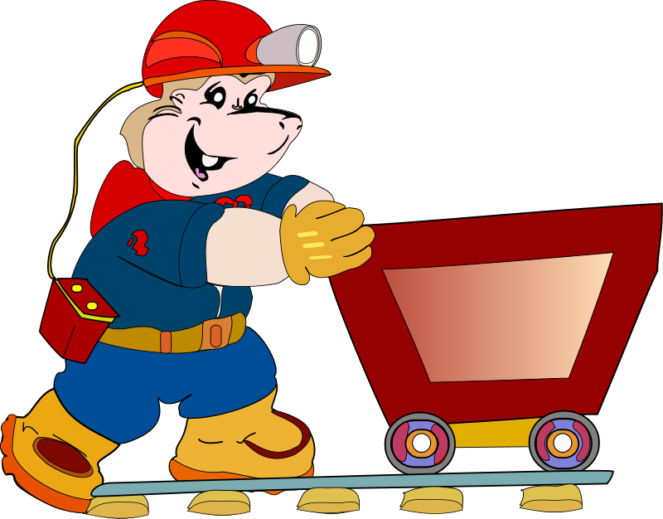
Data Mining – Meeting 6
Roi Yehoshua
Partially based on slides of Noam Koenigstein
The Open University

Slide 2
Agenda
Association Rules (Unit 8)
Apriori Algorithm

Slide 3
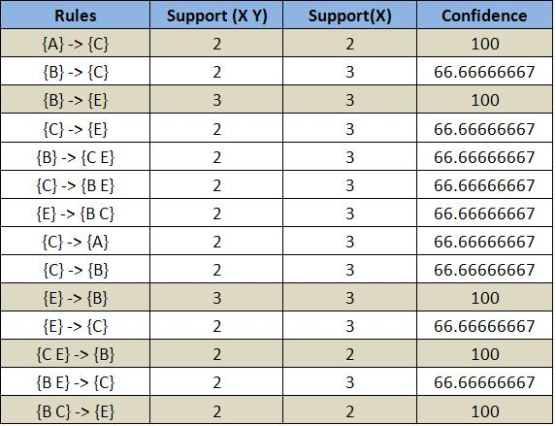
Association Rules Mining

Slide 4

Transaction
A “transaction” is defined by our data need:
Things I buy in one visit to the super
All books I purchased on Amazon (in one purchase/ever/previous year}
All search queries I submitted to Google (in some time frame)
All IP addresses I visited via the cellular portal
All symptoms I describe to the doctor in a visit.

Slide 5
Association rules
Dependency rules of the form: X→Y
If X, it is likely that Y.
(computer) →(anti-virus)
(computer) →(OS)
(computer, antivirus) →(OS)
(computer, antivirus, MS-OS)→(MS-office)
Probabilities are not given directly
Instead we use confidence and support as thresholds.
Rules are interpreted as correlations and not implications.

Slide 6
Itemsets
Itemset: a set of items that were involved in a “transaction”.
T₁:{bread, butter, milk, beer},
T₂:{bread, butter, milk}
T₃:{harry potter, da vinci code, criptonomicon}
T₄:{A,B,C,D,E,F}
s={bread, butter, milk} is an item set of 2 of the transctions

Slide 7
Association rules – Basic Concepts
Given itemsets of the form X={x₁, …, x_{k}}
Find all the rules X → Y with min confidence and support
Support (X → Y) , s, probability that a transaction contains X and Y
Confidence (X → Y) , c, conditional probability that a transaction having X also contains Y

Slide 8
Support
Note that this means a union of A and B
Support(A→B):
The probability of an itemset in our data.
Support(A→B) = Support(B→A)
Transactions:
a,b,c,d
d, e,f
d
a
b,c
a,b
b,c,e
b,c
d,f,a
itemset | Support
{a} | 4/9
{a,b} | 2/9
{b,c} | 4/9
{b,c,e} | 1/9
{b} | 5/9
… | …
8

Slide 9
A frequent itemset
An itemset that is more frequent than some threshold.
i.e. what are the frequent itemsets if threshold=2/9 ?
Transactions:
a,b,c,d
d, e,f
d
a
b,c
a,b
b,c,e
b,c
d,f,a
itemset | support
{a} | 4/9
{a,b} | 2/9
{b,c} | 4/9
{b} | 5/9
… | …
9

Slide 10
Apriori property
Any subset of a frequent itemset must be frequent
if {beer, diaper, nuts} is frequent, so is {beer, diaper}
Every transaction containing {beer, diaper, nuts} also contains {beer, diaper}
Apriori pruning principle
If there is any itemset which is infrequent, its superset should not be generated/tested
Notes:
(

Slide 11
Confidence
Confidence(A→B) =
The percentage of transactions that contain A that also contain B.
Transactions:
a,b,c,d
d, e,f
d
a
b,c
a,b
b,c,e
b,c
d,f,a
rule | confidence
a→b | 2/4
b→a | 2/5
b→c | 4/5
b,c→e | 1/4
… | …

Slide 12

Support and Confidence
Support - Measures how frequent is the rule.
Confidence - Measures the strength of the rule, once its preconditions are met.
The relationship between confidence and support:

Slide 13
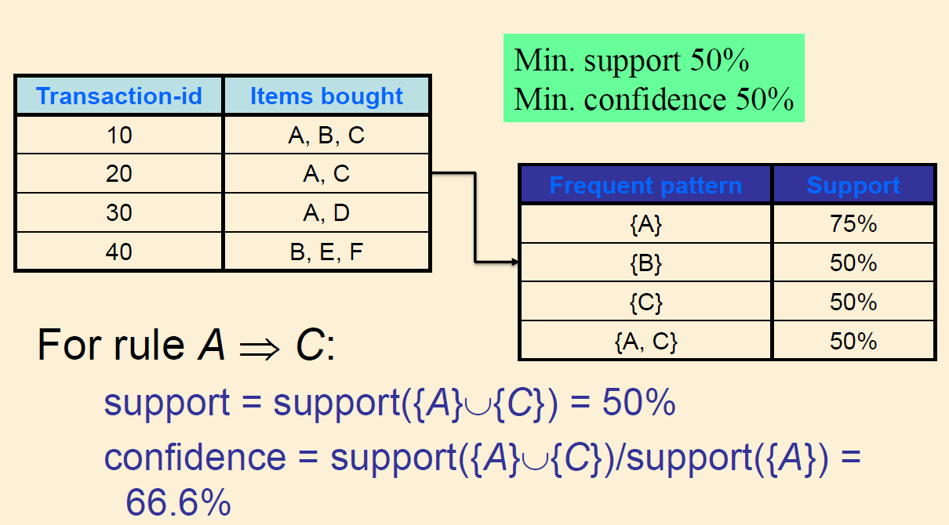
Association rules – An Example

Slide 14
Mining Association Rules
2 main steps for mining association rules:
Find all frequent itemsets (Itemsets with minimum support threshold)
Generate strong association rules from the frequent itemsets (these rules must satisfy both minimum support and minimum confidence)

Slide 15
Apriori Algorithm
An iterative approach: level wise search
Generate length (k+1) candidate itemsets from length k frequent itemsets by joining them with themselves
Prune (k+1)-itemsets containing infrequent k-itemsets
Test the remaining candidates against DB
Frequent itemsets are found using the Apriori Algorithm (verifies support), and then we need to check for confidence in rules.

Slide 16
Apriori Algorithm:
C_{k} set of candidate frequent itemsets of k items each
Thus not all itemsets in C_{k} are frequent
L_{k} set of frequent itemsets of k items each
All itemsets in L_{k} are frequent
In the join phase we create C_{k} from C_{k-1}
The apriory property enables efficient joining
In the prune phase we prune C_{k} to L_{k}
Hashing and other methods enable efficient pruning

Slide 17
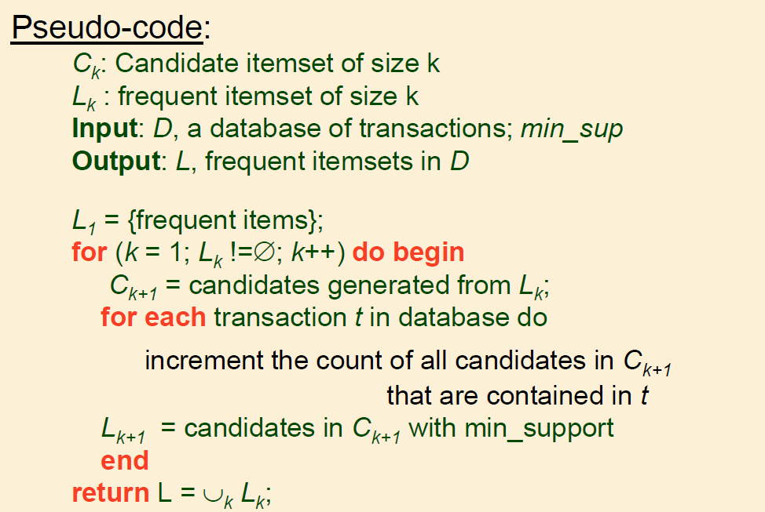
The Apriori Algorithm Outline

Slide 18
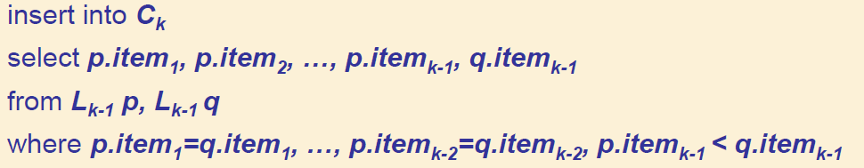
Join
We have a set L_{k-1} of frequent itemsets (of size k-1).
C_{k} = L_{k-1} |x| L_{k-1}
|x| is a selective join where only sets that share the first k-2 elements are joined
Note: for search efficiency, sets are ordered lexicorgaphically

Slide 19
Join
For example, if k=4, (k-1)=3 and L₃ = {{a,b,c}, {a,b,d}, {a,c,d}, {a,c,e},{b,c,d}}
then C₄ = {{a,b,c,d},{a,c,d,e}}
{a,b,c,d} from {a,b,c} and {a,b,d}
{a,c,d,e} from {a,c,d} and {a,c,e}
Note that {a,b,c,e} is not created from {a,b,c} and {a,c,e} although they share two elements, since in this case {a,b,e} would also have to belong to L₃, and if {a,b,c} and {a,b,e} belonged to L₃, then {a,b,c,e} would have been created anyway

Slide 20
Prune
First prune using the apriori rule: Any itemset that does not have all its k-1 itemsets frequent, can be removed.
For example, if L₃ = {{a,b,c}, {a,c,d}, {a,c,e},{b,c,d}} and C₄ = {{a,b,c,d},{a,c,d,e}}
then {a,c,d,e} is removed from C₄ because {a,d,e} is not in L₃
Then move to checking the support of the other itemsets by scanning the DB:
We compute support for each set in C_{k} and remove (prune) the non-frequent ones
This leaves us with L_{k}

Slide 21
Generate rules
Compute confidence of each subset of L_{final}.
If L_{final} = L_{k}, then for each itemset with k items l_{k} ,there are 2^{k}-1 possible rules
For each subset s (and complement s’=l_{k}-s) the confidence of the rule: s → s’ is given by: support(l_{k})/support(s)

Slide 22
The Apriori Algorithm—An Example
Sup_{min} = 2
Itemset | sup
{A} | 2
{B} | 3
{C} | 3
{D} | 1
{E} | 3
Database TDB
Itemset | sup
{A} | 2
{B} | 3
{C} | 3
{E} | 3
L₁
Tid | Items
10 | A, C, D
20 | B, C, E
30 | A, B, C, E
40 | B, E
C₁
1st scan
C₂
Itemset | sup
{A, B} | 1
{A, C} | 2
{A, E} | 1
{B, C} | 2
{B, E} | 3
{C, E} | 2
C₂
Itemset
{A, B}
{A, C}
{A, E}
{B, C}
{B, E}
{C, E}
L₂
Itemset | sup
{A, C} | 2
{B, C} | 2
{B, E} | 3
{C, E} | 2
2nd scan
C₃
Itemset
{B, C, E}
3rd scan
L₃
Itemset | sup
{B, C, E} | 2

Slide 23
Exercise
Given the following table:
Assuming:
Min_support = 60%
Min_confidence = 80%
Find all the frequent itemsets using the Apriori algorithm
Find all the strong association rules in those itemsets
Items_bought | TID
{M,O,N,K,E,Y} | T100
{D,O,N,K,E,Y} | T200
{M,A,K,E} | T300
{M,U,C,K,Y} | T400
{C,O,K,I,E} | T500

Slide 24
Challenges Of Frequent Pattern Mining
Challenges
Multiple scans of transaction database
Huge number of candidates
Tedious workload of support counting for candidates
Improving Apriori: general ideas
Reduce passes of transaction database scans
Shrink number of candidates
Facilitate support counting of candidates

Slide 25
How to Count Supports of Candidates?
Why counting supports of candidates a problem?
The total number of candidates can be very huge
One transaction may contain many candidates
Method:
Candidate itemsets are stored in a hash-tree
Leaf node of hash-tree contains a list of itemsets and counts
Interior node contains a hash table
Subset function: finds all the candidates contained in a transaction

Slide 26

Example: Construction Of Hash-Tree For C₃
Subset function
3,6,9
1,4,7
2,5,8
2 3 4
5 6 7
1 4 5
3 4 5
3 5 6
3 5 7
6 8 9
3 6 7
3 6 8
1 3 6
1 2 4
4 5 7
1 2 5
4 5 8
1 5 9
Each leaf node contains no more than 3 itemsets

Slide 27
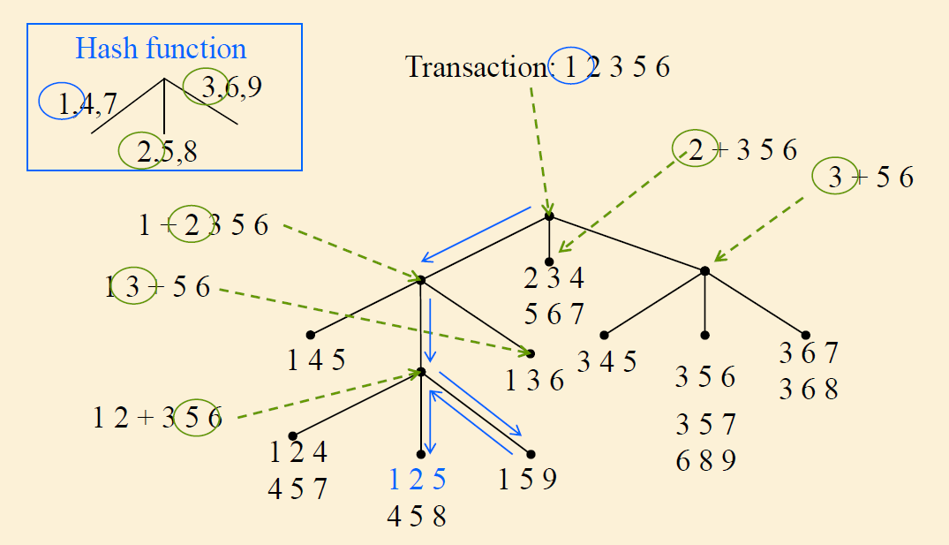
Example: Counting Supports of Candidates

Slide 28
Partition: Scan Database Only Twice
Any itemset that is potentially frequent in DB must be frequent in at least one of the partitions of DB
Scan 1: partition database and find local frequent patterns
Scan 2: consolidate global frequent patterns
A. Savasere, E. Omiecinski, and S. Navathe. An efficient algorithm for mining association in large databases. In VLDB’95
http://www.acm.org/sigmod/vldb/conf/1995/P432.PDF

Slide 29
Bottleneck of Frequent-pattern Mining
Multiple database scans are costly
Mining long patterns needs many passes of scanning and generates lots of candidates
To find frequent itemset i₁i₂…i₁₀₀
# of scans: 100
# of candidates: 2¹⁰⁰-1 ~1.27*10³⁰ !
Bottleneck: candidate-generation-and-test
Can we avoid candidate generation?

Slide 30
Mining Frequent Patterns Without Candidate Generation
Grow long patterns from short ones using local frequent items
abc is a frequent pattern
Get all transactions having “abc”: DB|abc
d is a local frequent item in DB|abc → abcd is a frequent pattern

